Slide 1
Module 4 Week 2 - MongoDB

Slide 2
MongoDB Roadmap
Week 1
Week 1 Review
MongoDB – How to Query
Aggregation Framework
Relations in MongoDB
CRUD
Inserting
Updating
Deleting
Indexing
Replica Sets
MongoDB Transactions
MongoDB 4.0 multi-document
JSON Schema Validation
Lab 2

Slide 3
Week 1 Review
MongoDB – document-oriented database
Concept of row replaced with document
Embedded documents, arrays
Complex hierarchical relationships in single record
No predefined schema
Document keys and values are not of fixed types/sizes
Adding/removing fields easier
Makes development easier
Can have some schema aspects!
Notes:
RDBMS – challenging in the past 10 years, First you have single server with a small data set. Then we find ourselves setting up replication so that we can scale out reads and deal with potential failures. Before long we added caching layer, tunned all queries, thrown even more hardware at problem. Eventually need to shard data across multiple clusters and rebuild ton of application logic to deal with it. And soon after you realize you have locked into a schema you modeled so long time ago. Altering the schema with so much data will take forever, its easier to do it in code. This can keep small team of developers busy for many months.
MongoDB doesn’t try to be everything to everyone. Instead it strikes the right balance between features and complexity, with a clear bias toward making previously difficult tasks far easier. In other words, it has the features that really matter to the vast majority of today’s web applications: indexes, replication, sharding, a rich query syntax, and a very flexible data model. All of this comes without sacrificing speed.
The primary reason for moving away from the relational model is to make scaling out easier, but there are some other advantages as well
It is also easier to experiment. Developers can try dozens of models for the data and then choose the best one to pursue.

Slide 4
Week 1 Review
MongoDB – document-oriented database
Easy scaling
Designed to be general-purpose database
Supports lots of features
Indexing
Aggregation
File storage
Notes:
Scaling up is often the path of least resistance, but it has drawbacks: large machines are often very expensive, and eventually a physical limit is reached where a more powerful machine cannot be purchased at any cost. The alternative is to scale out: to add storage space or increase performance, buy another commodity server and add it to your cluster. This is both cheaper and more scalable; however, it is more difficult to administer a thousand machines than it is to care for one. MongoDB was designed to scale out. Its document-oriented data model makes it easier for it to split up data across multiple servers. MongoDB automatically takes care of balancing data and load across a cluster, redistributing documents automatically and routing user requests to the correct machines. This allows developers to focus on programming the application, not scaling it
Indexing - MongoDB supports generic secondary indexes, allowing a variety of fast queries, and provides unique, compound, geospatial, and full-text indexing capabilities as well
Aggregation - MongoDB supports an “aggregation pipeline” that allows you to build complex aggregations from simple pieces and allow the database to optimize it
File Storage – large files + metadata
A document database is, at its core, a key/value store with one major exception. Instead of just storing any blob in it, a document db requires that the data will be store in a format that the database can understand (i.e. JSON, XML etc). In most doc dbs, that means that we can now allow queries on the document data.

Slide 5
Week 1 Review
Document – basic unit of data like row in RDMBS
Collection – like table (in RDBMS) with dynamic schema
Single instance of MongoDB can have multiple databases with its own collections
Every document has special key _id
MongoDB comes with JavaScript shell
Notes:
_id unique to each collection
Shell – administer databases and manipulate data
IntelliShell - a the built-in mongo shell with smart autocompletion of JavaScript standard library functions, shell-specific types and methods, operators, collection names, field names, shell helper commands, and more.
A "Key-Value database" defines that the "Value" part of the data to retrieve can be accessed directly by querying the database for its "Key", as opposed to define database schemas and querying the database using SQL syntax. The "Value" could be anything, a simple string, a programming language object, an HTML page...
Document database says more about the "Value" part of the Key-Value pair: the data retrieved is encoded in some standard, portable format, as JSON or XML. This gives the database some structure, but nowhere near as rigid as a traditional database where every row has to conform to the defined schema.
So, to answer your question, MongoDB is a database that uses a "Key-Value" mechanism to retrieve data, with its "Value" being a Document (as loosely defined by the definition of Document based database).
Take into account that the NoSQL "definitions" are a bit overlapping and quite loose.

Slide 6
Week 1 Review
“_id” – every document in MongoDB must have it
Every document must have unique id
ObjectId – default type of “_id”
ObjectID – is actually a BSON type
Lightweight class
Notes:
MongoDB’s distributed nature is the main reason why it uses ObjectIds as opposed to something more traditional, like an autoincrementing primary key: it is difficult and time-consuming to synchronize autoincrementing primary keys across multiple servers. Because MongoDB was designed to be a distributed database, it was important to be able to generate unique identifiers in a sharded environment.
Finally, keep in mind that the _id field is immutable — that is, once a document exists in your MongoDB system, it has, by definition, been assigned an _id, and you cannot change its primary key. That said, _id can be overridden when you insert new documents, but by default it will be populated with an ObjectID. Overriding the _id field for a document can be useful, but when you do so, you need to ensure that the values for each document are unique.

Slide 7
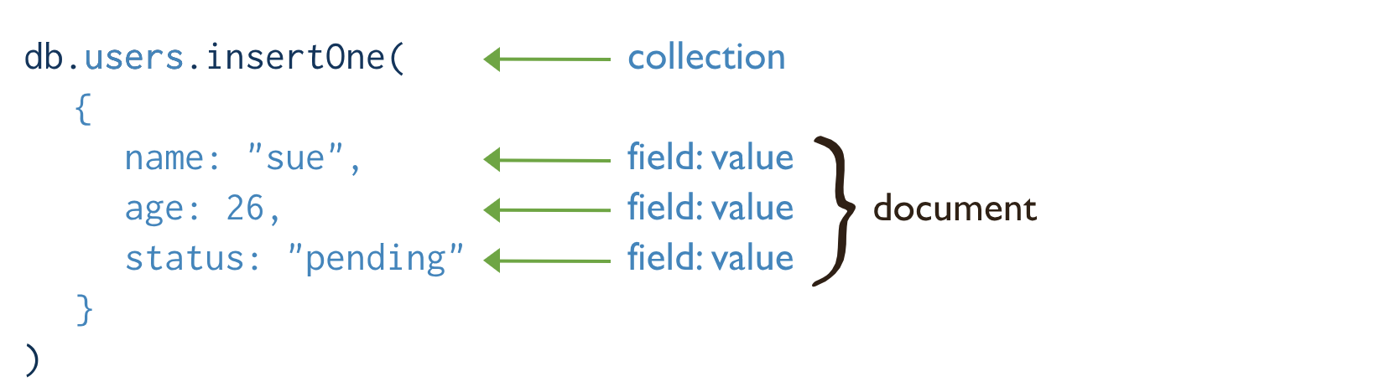
Week 1 Review
Notes:
Collection – group of documents (document is ordered set of keys and values). Is identified by its name (USERS)
Most documents have multiple key/value pairs
Values can be one of several data types (or even entire Embedded documents).
Keys in document are strings (name, age, status)
Documents cant contain duplicate keys, key/value pairs are ordered
Collections have dynamic schemas – documents within a single collection can have any number of different shapes, like this collection has strings and integer

Slide 8
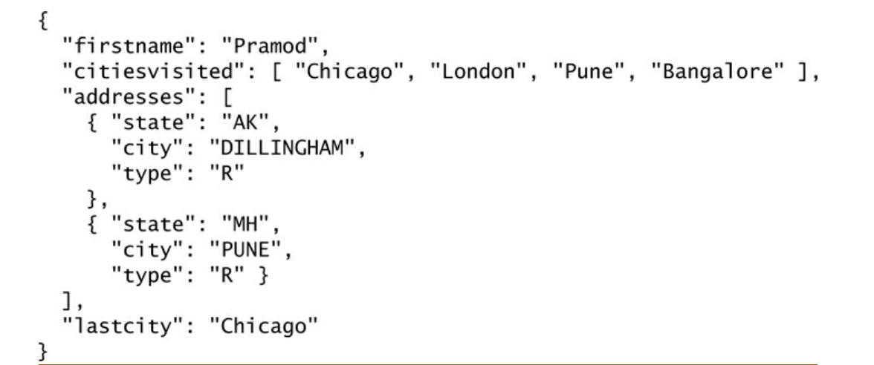
Why have different collections?
Notes:
Keeping different kinds of documents in same collection can be a nightmare for developers and admins. Developers need to make sure that each query is only returning documents of a certain type or that the application code performing a query can handle documents of different shapes. If we’re querying for blog posts, it’s a hassle to weed out documents containing author data.
It is much faster to get a list of collections than to extract a list of the types in a collection. For example, if we had a "type" field in each document that specified whether the document was a “skim,” “whole,” or “chunky monkey,” it would be much slower to find those three values in a single collection than to have three separate collections and query the correct collection.
Grouping documents of the same kind together in the same collection allows for data locality. Getting several blog posts from a collection containing only posts will likely require fewer disk seeks than getting the same posts from a collection containing posts and author data.

Slide 9
Querying in MongoDB
Can perform ad hoc queries using find() and findOne()
Query for ranges, set inclusions, inequalities and more using $-conditions
Queries return database cursor
Returns batches of documents
Operations on cursor
Skipping certain number of results returned
Limiting number of results
Sorting
Notes:
An Ad-Hoc Query is a query that cannot be determined prior to the moment the query is issued.
Find() brings back CURSOR not all the data (will see in the lab)
Oracle creates a memory area, known as the context area, for processing an SQL statement, which contains all the information needed for processing the statement; for example, the number of rows processed, etc. A cursor is a pointer to this context area. PL/SQL controls the context area through a cursor.
A pointer to the result set of a query. Clients can iterate through a cursor to retrieve results. ... Essentially, the cursor is the conduit you will use to extract all the results of a query from the database.
Python cursor class

Slide 10
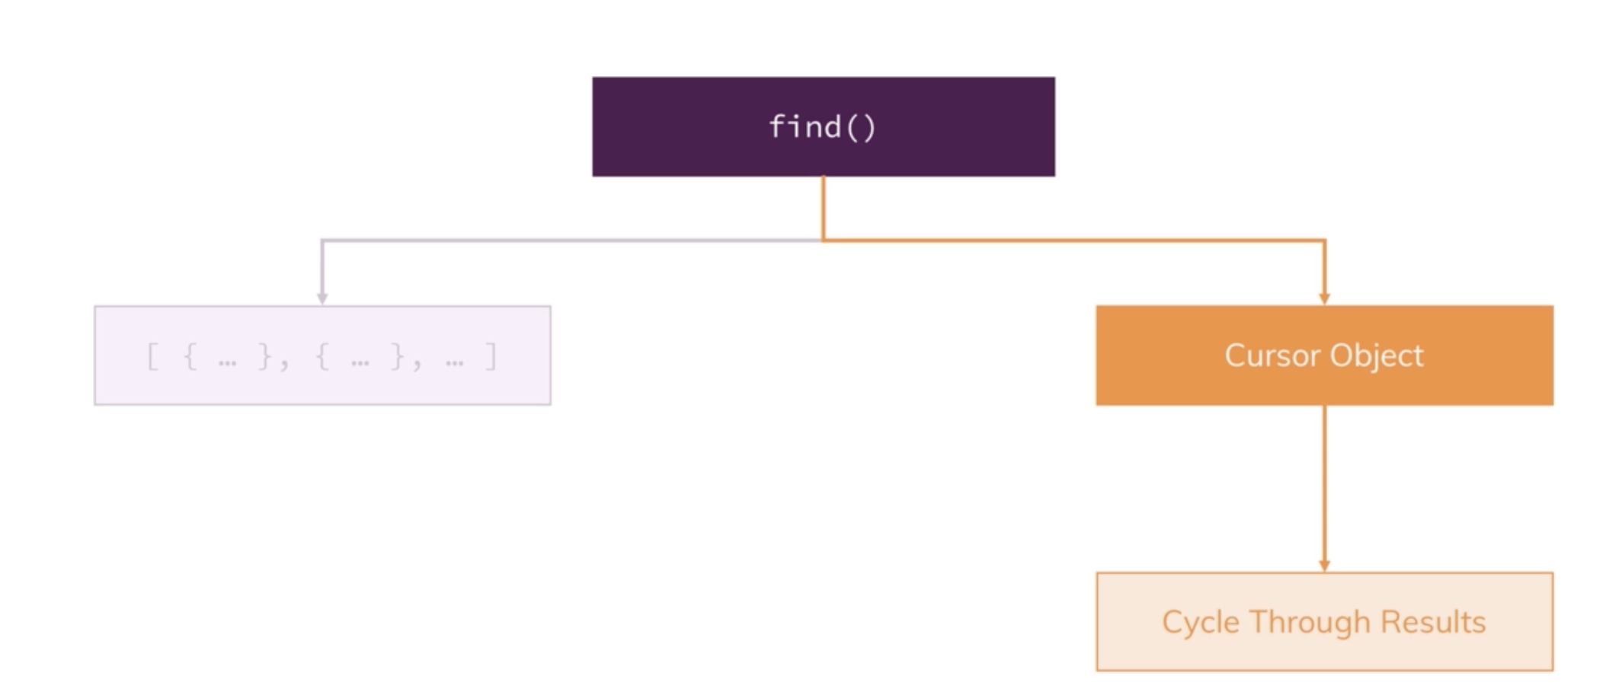
Querying in MongoDB
Notes:
Find() brings back CURSOR not all the data (will see in the lab) – collections can be very big. If we have 20 million documents in our collection, that would take forever.
Instead, it brings back CURSOR object with lots of metadata behind it that allows us to cycle through the results
Cursors do not exist on update, insert or delete because these do not bring back the data, they operate on the data

Slide 11

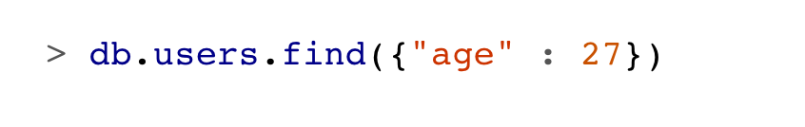
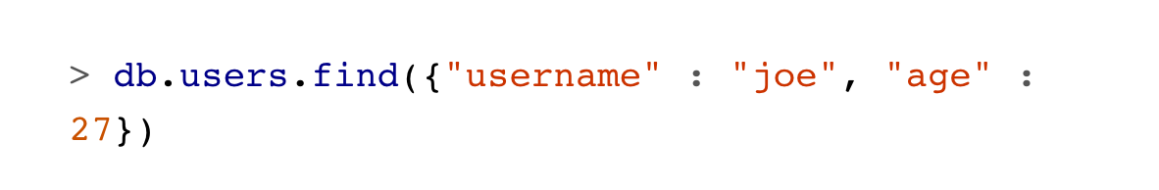
Querying in MongoDB
MongoDB provides db.collection.find() method to perform queries
Querying returns subset of documents
Notes:
Find() brings back CURSOR not all the data (will see in the lab)
Querying returns subset of documents from no documents to the entire collection
-which documents get returned depends on the argument to find()
Db.c.find() – will return all documents in collection c
When we start adding key/value pairs to the query document, we begin restricting our search. This works in a straightforward way for most types: numbers match numbers, booleans match booleans, and strings match strings. Querying for a simple type is as easy as specifying the value that you are looking for. For example, to find all documents where the value for "age" is 27, we can add that key/value pair to the query document
Multiple conditions can be strung together by adding more key/value pairs to the query document, which gets interpreted as “condition1 AND condition2 AND … AND conditionN.” For instance, to get all users who are 27-year-olds with the username “joe,” we can query for the following:

Slide 12
Querying in MongoDB
Use findOne() to retrieve a single item from your collection
Returns the same result as find(), but less intensive on CPU
Use when you expect one result
Notes:
So far we’ve only looked at examples that show how to retrieve multiple documents. If you want to receive only one result, however, querying for all documents— which is what you generally do when executing a find() function— would be a waste of CPU time and memory. For this case, you can use the findOne() function to retrieve a single item from your collection. Overall, the result is identical to what occurs when you append the limit(1) function, but why make it harder on yourself than you should?

Slide 13
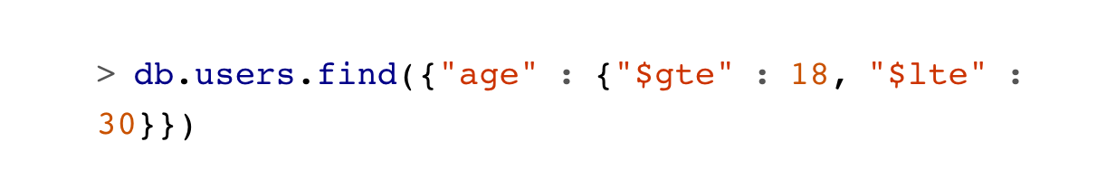
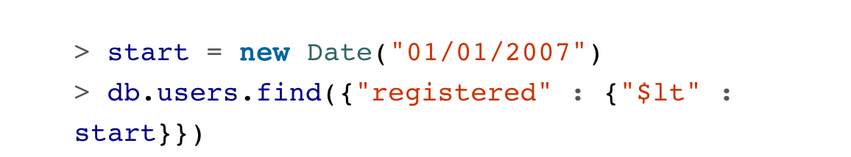
Query Criteria
Query conditionals
“$lt”, “$lte”, “$gt”, “$gte” - comparison operators
Correspond to <, <=, >, >=
Can be combined to look for a range of values
Notes:
Queries can go beyond exact matching described previously
Queries can match ranges, OR-clauses and negation
Example 1: Getting all documents where the “age” field is greater than or equal to 18 AND less than or equal to 30
Example 2: These types of range queries are often useful for dates. For example, to find people who registered before January 1, 2007, we can do this.
An exact match on a date is less useful, since dates are only stored with millisecond precision. Often you want a whole day, week, or month, making a range query necessary.

Slide 14
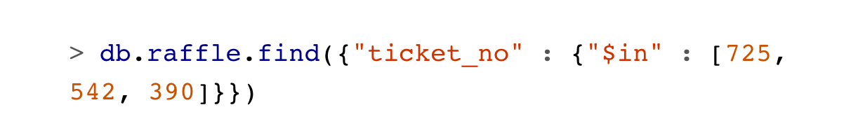
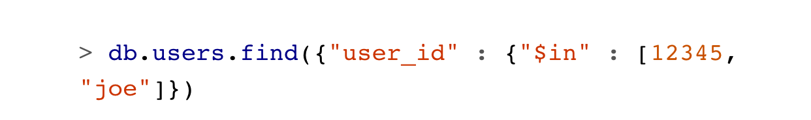
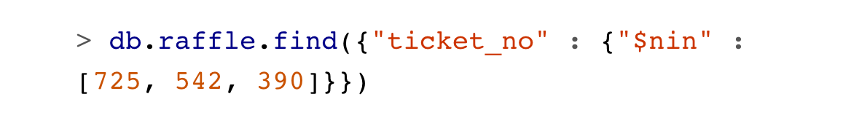
OR Query
There are two ways to do an OR query in MongoDB
“$in” – query for variety of values for a single key (like IN in MySQL)
“$or” – query for any of the given values across multiple keys
“$nin” – query for specified field that does NOT have a value
Notes:
Example 1: If you have more than one possible value to match for a single key, use an array of criteria with "$in". For instance, suppose we were running a raffle and the winning ticket numbers were 725, 542, and 390. To find all three of these documents, we can construct the following query
Example 2: "$in" is very flexible and allows you to specify criteria of different types as well as values.
Example 3: The opposite of "$in" is "$nin", which returns documents that don’t match any of the criteria in the array.

Slide 15
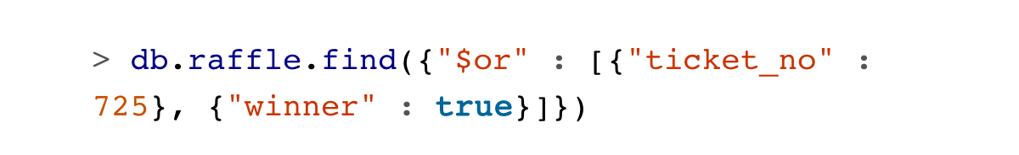
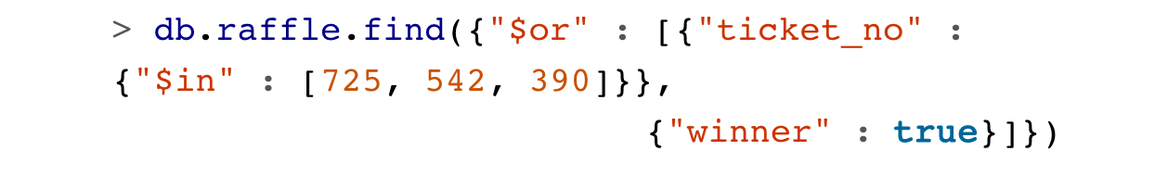
OR Query
“$or” – search for multiple expressions in a single query
Only one criterion needs to match to return given document
Unlike “$in”, “$or” allows you to specify both they key and the value, rather than only the value
Notes:
Example 1: "$in" gives you an OR query for a single key, but what if we need to find documents where "ticket_no" is 725 or "winner" is true? For this type of query, we’ll need to use the "$or" conditional. "$or" takes an array of possible criteria. In the raffle case, using "$or" would look like this:
Example 2: If we want to match any of the three "ticket_no" values or the "winner" key, we can use this:
With a normal AND-type query, you want to narrow down your results as far as possible in as few arguments as possible. OR-type queries are the opposite: they are most efficient if the first arguments match as many documents as possible.

Slide 16
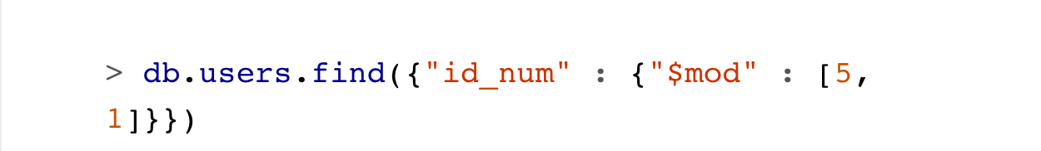
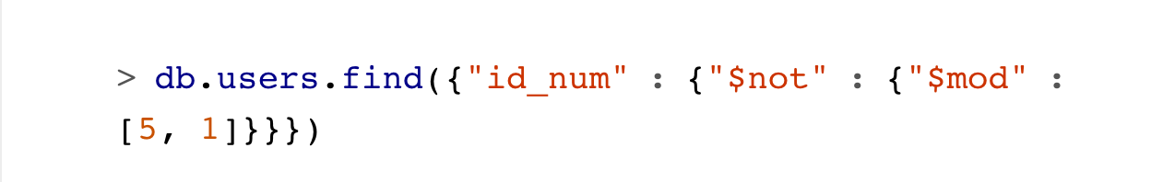
Queries - $not
“$not” – can be applied on top of any other criteria
Notes:
"$not" can be particularly useful in conjunction with regular expressions to find all documents that don’t match a given pattern
As an example, let’s consider the modulus operator, "$mod". "$mod" queries for keys whose values, when divided by the first value given, have a remainder of the second value
The previous query returns users with "id_num"s of 1, 6, 11, 16, and so on. If we want, instead, to return users with "id_num"s of 2, 3, 4, 5, 7, 8, 9, 10, 12, etc., we can use "$not":
The $mod operator is used to help the user to retrieve documents from a collection for a specific field that consist an even or odd number.

Slide 17
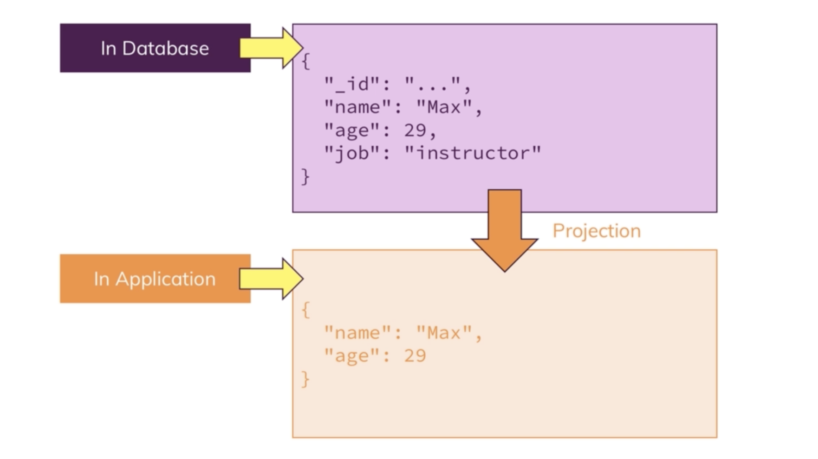
Projections
Notes:
Suppose in the database we have document that looks like that. But in application we only want to get name and age. We can fetch all the data and filter it in the application, you will be transferring the data over to the wire though, impacting bandwidth and possibly fetch unnecessary data.
Alternatively, you can filter this out on the MongoDB server, before the data is shipped to you
Use in find() and findOne() methods
Will see how to do it in the lab

Slide 18

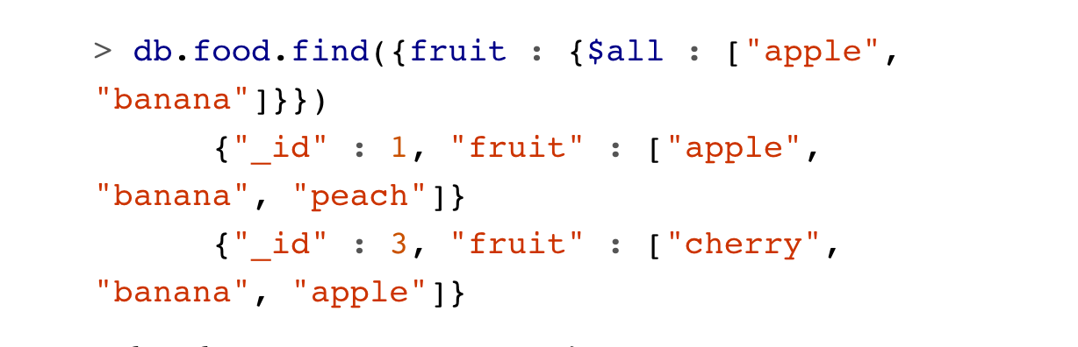
Querying Arrays
Query arrays same was as scalars
Use $all to match arrays by more than one element
Notes:
Example1: to get one element of the array (say we had banana, apple and peach in in)
Example 2: Getting list of elements with apple and banana in it

Slide 19
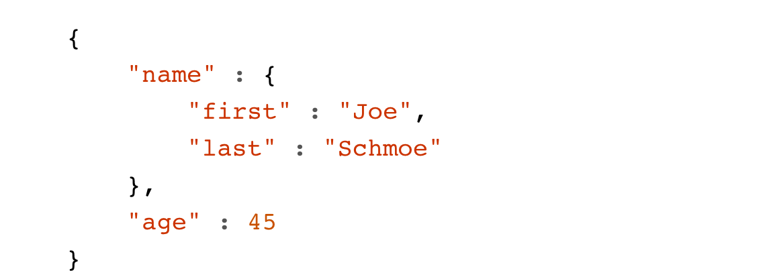
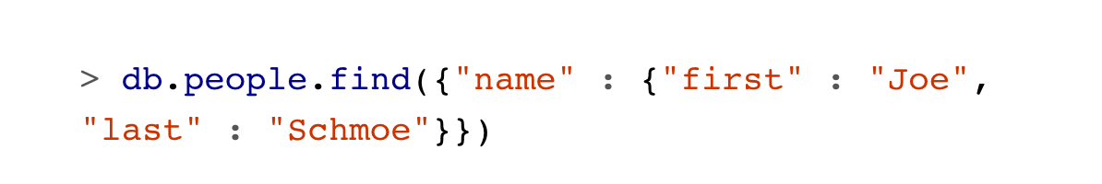
Querying on Embedded Documents
Two ways to query for embedded document
Query for the whole document
Query for its individual key/value pairs
Notes:
Query for entire embedded document = works like a normal query
If we have a document that looks like this, we can query for Joe Schmoe
However, a query for a full subdocument must exactly match the subdocument. If Joe decides to add a middle name field, suddenly this query won’t work anymore; it doesn’t match the entire embedded document! This type of query is also order-sensitive: {"last" : "Schmoe", "first" : "Joe"} would not be a match.
If possible, it’s usually a good idea to query for just a specific key or keys of an embedded document.

Slide 20
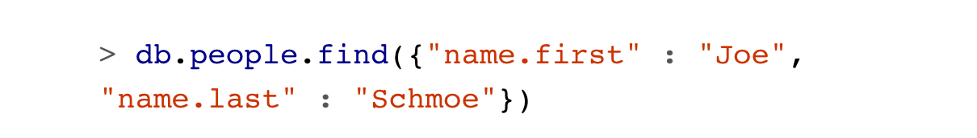
Querying on Embedded Documents
Query for its individual key/value pairs using dot-notation
Notes:
If you use key/value pairs, when your schema changes, all of your queries wont suddenly break because there are no longer exact matches.
Now, if Joe adds more keys, this query will still match his first and last names
Embedded document matches can get a little tricky as the document structure gets more complicated.

Slide 21
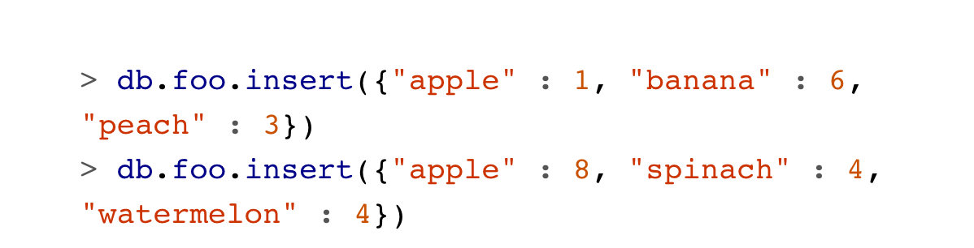
$where Queries
Use $where for queries that cannot be done any other way
Allow you to execute arbitrary JavaScript as part of query
For security, use of $where should be highly restricted or eliminated
End users should never be allowed to execute $where clauses
Most common case – compare values for two keys in a document
Notes:
.For example, we have documents that look like this
We’d like to return documents where any two of the fields are equal. For example, in the second document, "spinach" and "watermelon" have the same value, so we’d like that document returned.
It’s unlikely MongoDB will ever have a $-conditional for this, so we can use a "$where" clause to do it with JavaScript:

Slide 22
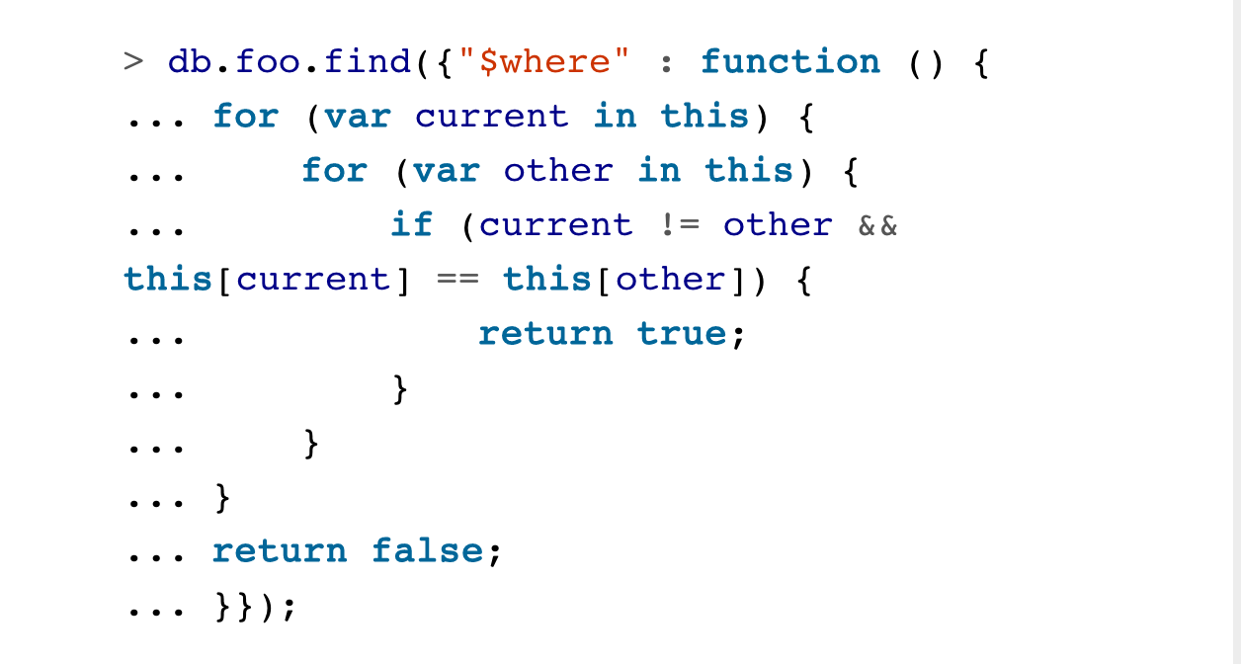
$where Queries
Use $where for queries that cannot be done any other way
Notes:
If the function returns true, the document will be part of the result set; if it returns false, it won’t be. "$where" queries should not be used unless strictly necessary: they are much slower than regular queries. Each document has to be converted from BSON to a JavaScript object and then run through the "$where" expression. Indexes cannot be used to satisfy a "$where", either.
You should use "$where" only when there is no other way of doing the query.
You must be very careful with security when executing JavaScript on the server. If done incorrectly, server-side JavaScript is susceptible to injection attacks similar to those that occur in a relational database. However, by following certain rules around accepting input, you can use JavaScript safely

Slide 23
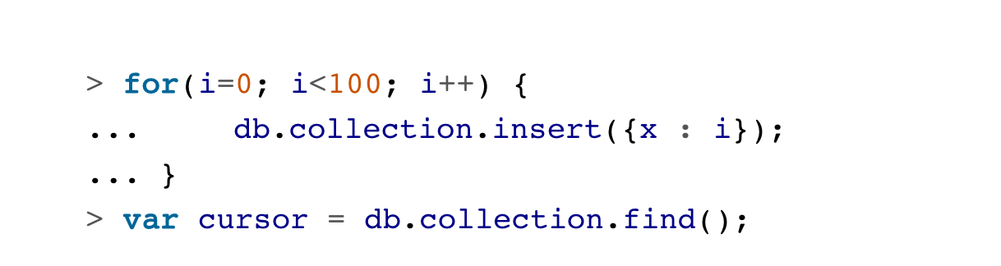
Cursors
Database returns results from find() using a cursor
Can limit number of results
Sort results
Perform other powerful operations
Notes:
To create a cursor with the shell, put some documents into a collection, do a query on them, and assign the results to a local variable (variables defined with "var" are local). Here, we create a very simple collection and query it, storing the results in the cursor variable:
The advantage of doing this is that you can look at one result at a time. If you store the results in a global variable or no variable at all, the MongoDB shell will automatically iterate through and display the first couple of documents.

Slide 24
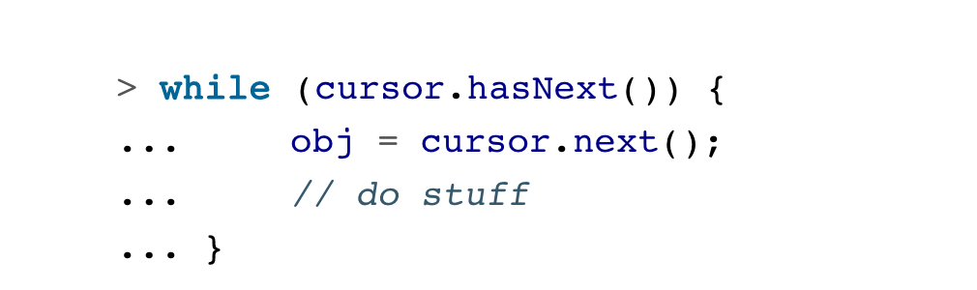
Cursors
To iterate through cursor results, use next method on the cursor
Can use hasNext to check whether there is another result
Example: typical loop through results
Notes:
cursor.hasNext() checks that the next result exists, and cursor.next() fetches it.

Slide 25

Limits, Skips and Sorts
Must be added before query is sent to the database
To set limit – chain limit() function onto the call to find
Notes:
Most common query options – limiting the number of results, skipping the number of results and sorting.
Limit - If there are fewer than three documents matching your query in the collection, only the number of matching documents will be returned; limit sets an upper limit, not a lower limit.
Example 1: return 3 results

Slide 26
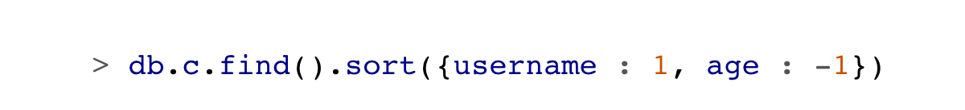
Limits, Skips and Sorts
Sort() takes an object: a set of key/value pairs
Keys – key names
Values – sort directions
Direction: 1 ascending -1 descending
Notes:
to sort the results by "username" ascending and "age" descending, we do the following

Slide 27
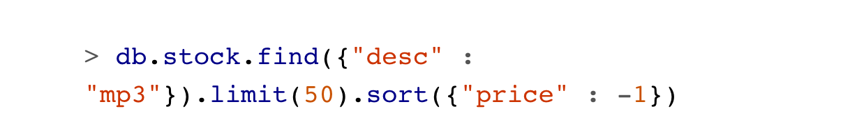
Limits, Skips and Sorts
Sort() takes an object: a set of key/value pairs
Keys – key names
Values – sort directions
Direction: 1 ascending -1 descending
Notes:
Example 1: to sort the results by "username" ascending and "age" descending, we do the following
Example2: often handy for pagination. For example, suppose that you are running an online store and someone searches for mp3. If you want 50 results per page sorted by price from high to low, you can do the following:

Slide 28
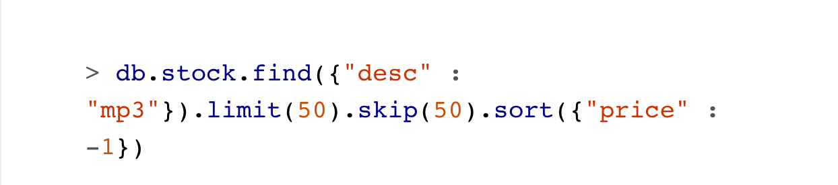
Limits, Skips and Sorts
Skip() skips over specified number of matches
Large skips are bad for performance
Use for small number of documents
Notes:
If we click Next Page to see more results, you can simply add a skip to the query, which will skip over the first 50 matches (which the user already saw on previous slide
For large skips, mongo has to find and then discard all the skipped results

Slide 29
Aggregation
Aggregation operations process data records – return computed results
Group values from multiple documents together – return single result
MongoDB provides 3 ways for aggregation:
Aggregation pipeline
Map-reduce function
Single purpose aggregation methods
Notes:
Group values from multiple documents together, perform different operations on grouped data and return single result
We can process data records and return computed results. Find bunch of cool information that is already inside of our collections → computation

Slide 30
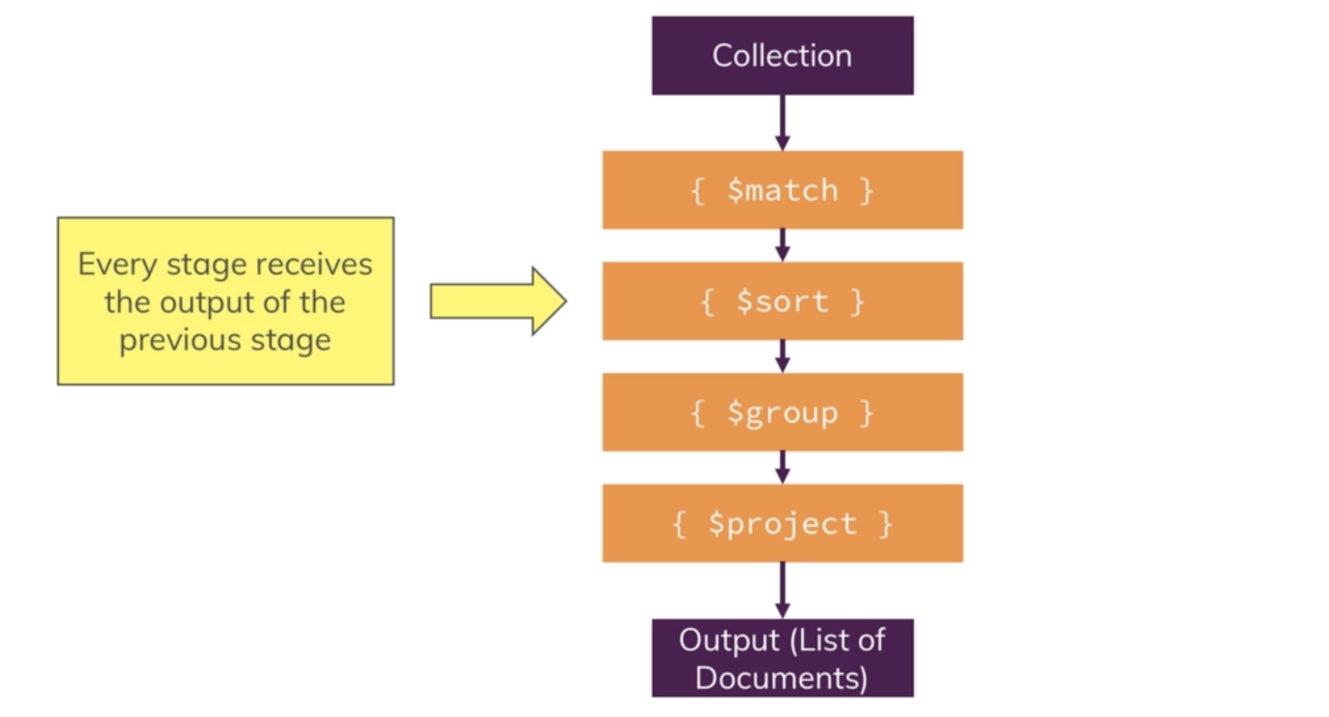
Aggregation Pipeline
https://docs.mongodb.com/manual/reference/operator/aggregation-pipeline/
Notes:
Collection – we build a pipeline of steps that run on the data and give you the output in the form that you need
$match allows you to filter down your results, for example
Very powerful way of modeling data transformation
Every stage gets output from previous stage
So you get data and slowly modify it to the way you need it at the end

Slide 31

Aggregation
Aggregate Commands - Count(), Distinct(), Group()
Aggregation framework
Count() – returns the number of documents
Notes:
Example 2 – additional filtering by combining count() with conditional operators
Example 3 - This example returns only the number of documents added in the collection that are published by Address and of the type Book. Note that the count() function ignores a skip() or limit() parameter by default. To ensure that your query doesn’t skip these parameters and that your count results will match the limit and/or skip parameters, use count(true)
Aggregation Framework – alternative to find methods.

Slide 32
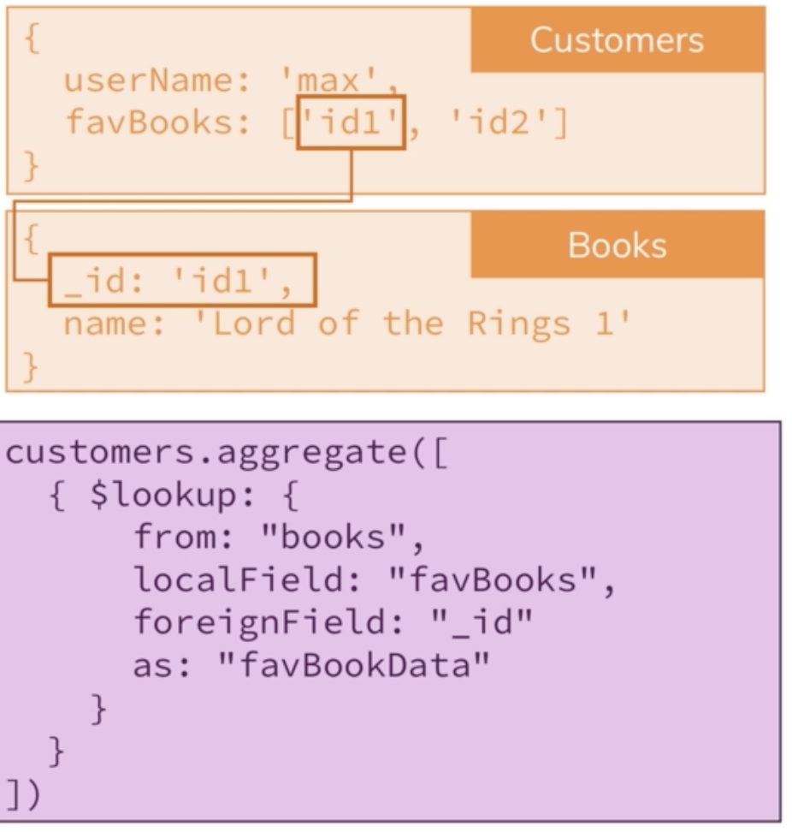
$lookup
https://docs.mongodb.com/manual/reference/operator/aggregation/lookup/
Notes:
- lets you combine information from two collections (its like a left outer join)
MongoDB is not a relational database, but you can perform a left outer join by using the $lookup stage. The $lookup stage lets you specify which collection you want to join with the current collection, and which fields that should match
Join multiple collections with $lookup
Use to join documents that use reference approach
$lookup – how you do joins in MongoDB
Useful tool using aggregation framework allows you to fetch to related documents and merge together – mitigates some disadvantages of splitting documents across collections

Slide 33
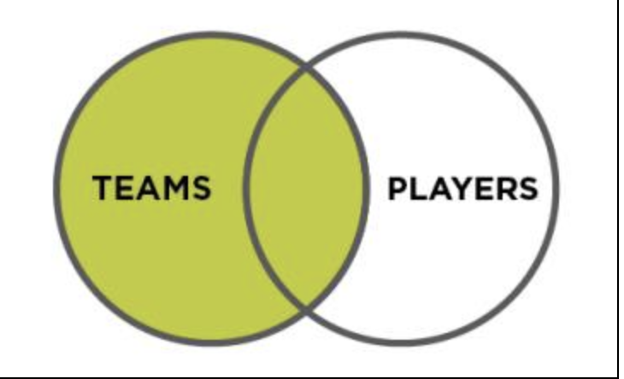
$lookup
https://docs.mongodb.com/manual/reference/operator/aggregation/lookup/
Notes:
The result set of a LEFT OUTER join contains all rows from both tables that meet the WHERE clause criteria, same as an INNER join result set. In addition, any rows from the left table that do not have a matching row that exists in the right table will also be included in the result set. The columns being selected from the right side table will return NULL values

Slide 34
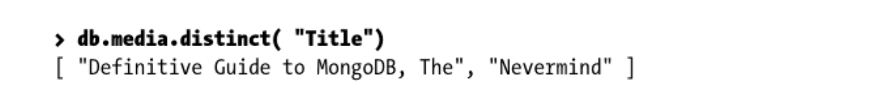
Aggregation Commands
Distinct() – retrieve unique values

Slide 35
Aggregation Commands
Group() – for grouping results
Similar to GROUP BY in MySQL
Returns array of grouped items
Takes three parameters: key, initial and reduce
Key – specifies which results to group
Initial – base number of items to start with
Reduce – groups all similar items together
Notes:
The key parameter specifies which results you want to group. For example, assume you want to group results by Title . The initial parameter lets you provide a base for each grouped result (that is, the base number of items to start off with). By default, you want to leave this parameter at zero if you want an exact number returned.
The reduce parameter groups all similar items together. Reduce takes two arguments: the current document being iterated over and the aggregation counter object. These arguments are called items and prev in the example that follows. Essentially, the reduce parameter adds a 1 to the sum of every item it encounters that matches a title it has already found.

Slide 36
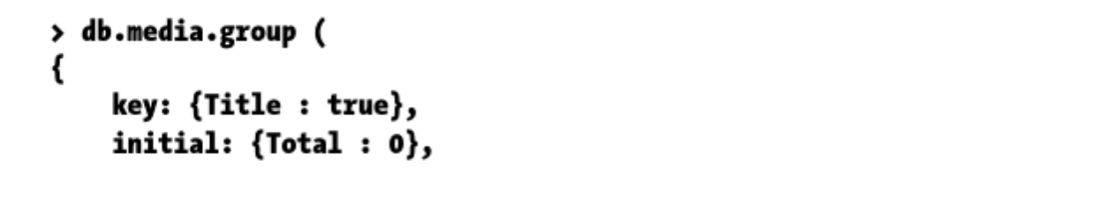
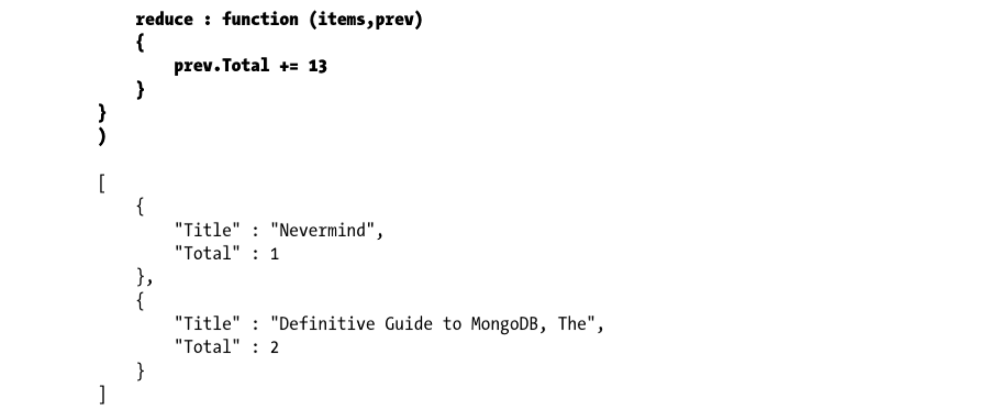
Aggregation Commands
Notes:
want to obtain a list of all unique titles of any type of item in your collection. Additionally, assume you want to group them together if any doubles are found, based on the title
The key parameter specifies which results you want to group. For example, assume you want to group results by Title . The initial parameter lets you provide a base for each grouped result (that is, the base number of items to start off with). By default, you want to leave this parameter at zero if you want an exact number returned.
The reduce parameter groups all similar items together. Reduce takes two arguments: the current document being iterated over and the aggregation counter object. These arguments are called items and prev in the example that follows. Essentially, the reduce parameter adds a 1 to the sum of every item it encounters that matches a title it has already found.

Slide 37
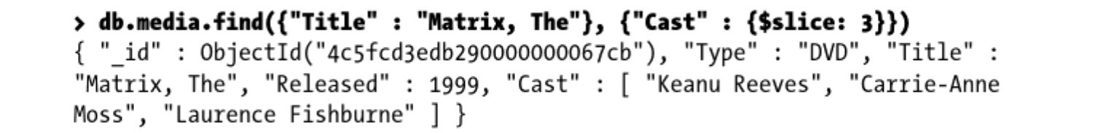
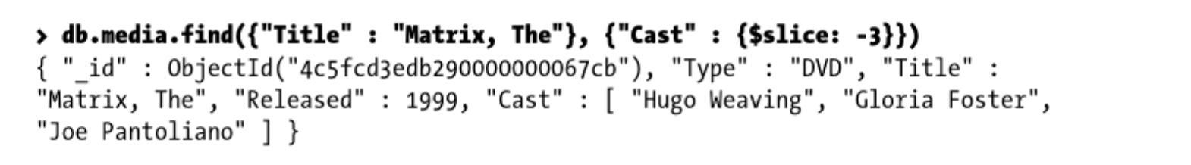
Retrieving a Document with $slice
Use $slice operator to retrieve document that includes specific area from an array in that document
Useful in limiting set of items
Can retrieve results n items per page (paging)
Notes:
In theory, the $slice operator combines the capabilities of the limit() and skip() functions; however, limit() and skip() do not work on an array, whereas $slice does. The operator takes two parameters; the first indicates the total number of items to be returned. The second parameter is optional; if used, it ensures that the first parameter defines the offset, while the second defines the limit. The limit parameter can also indicate a negative condition.
Example 1 – Limiting items from the Cast list to the first 3 items
Example 2 – Last 3 items by making the integer negative

Slide 38
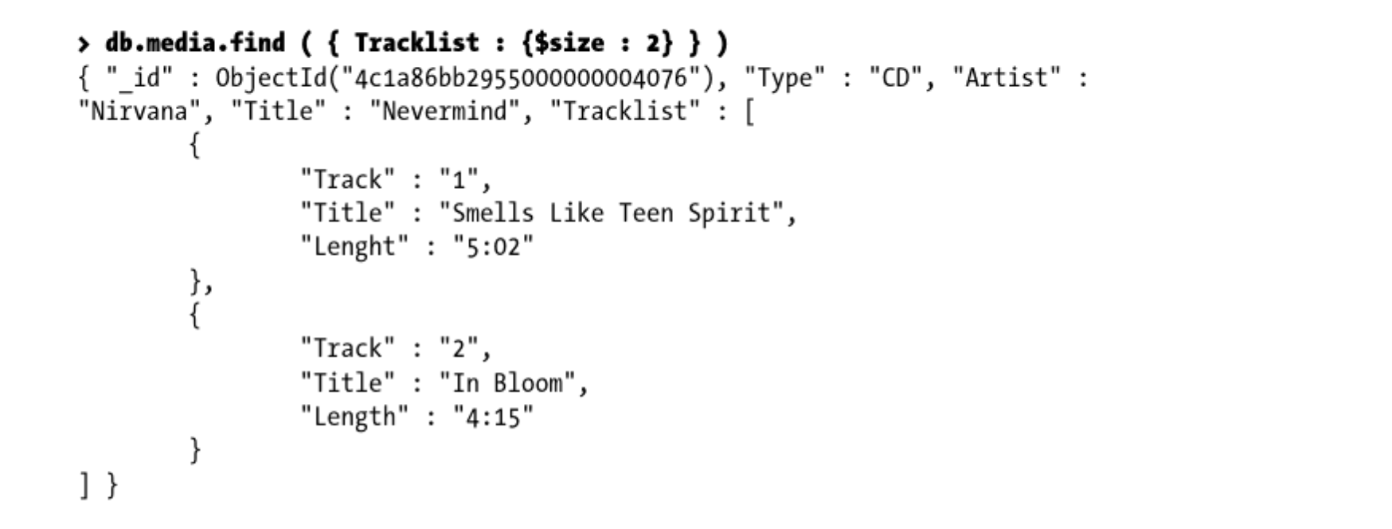
Filtering Results with $size
Use $size to filter results to match an array with the specified number of elements in it
Cannot use $size operator to find a range of sizes
Notes:
You cannot use the $size operator to find a range of sizes. For example, you cannot use it to find arrays with more than one element in them.
Example 1 – Search for those CDs that have exactly two songs on them:

Slide 39
Return specific object with $exists
Use $exists to return specific object if a specified field is either missing or found
Cannot use index if using $exists
Notes:
Example 1 : Return all items in the collection with a key named Author
Example 2: if we invoke $exits operator with a value of false, all documents that don’t have a key named Author will be returned.
Currently, the $exists operator is unable to use an index; therefore, using it requires a full table scan.

Slide 40
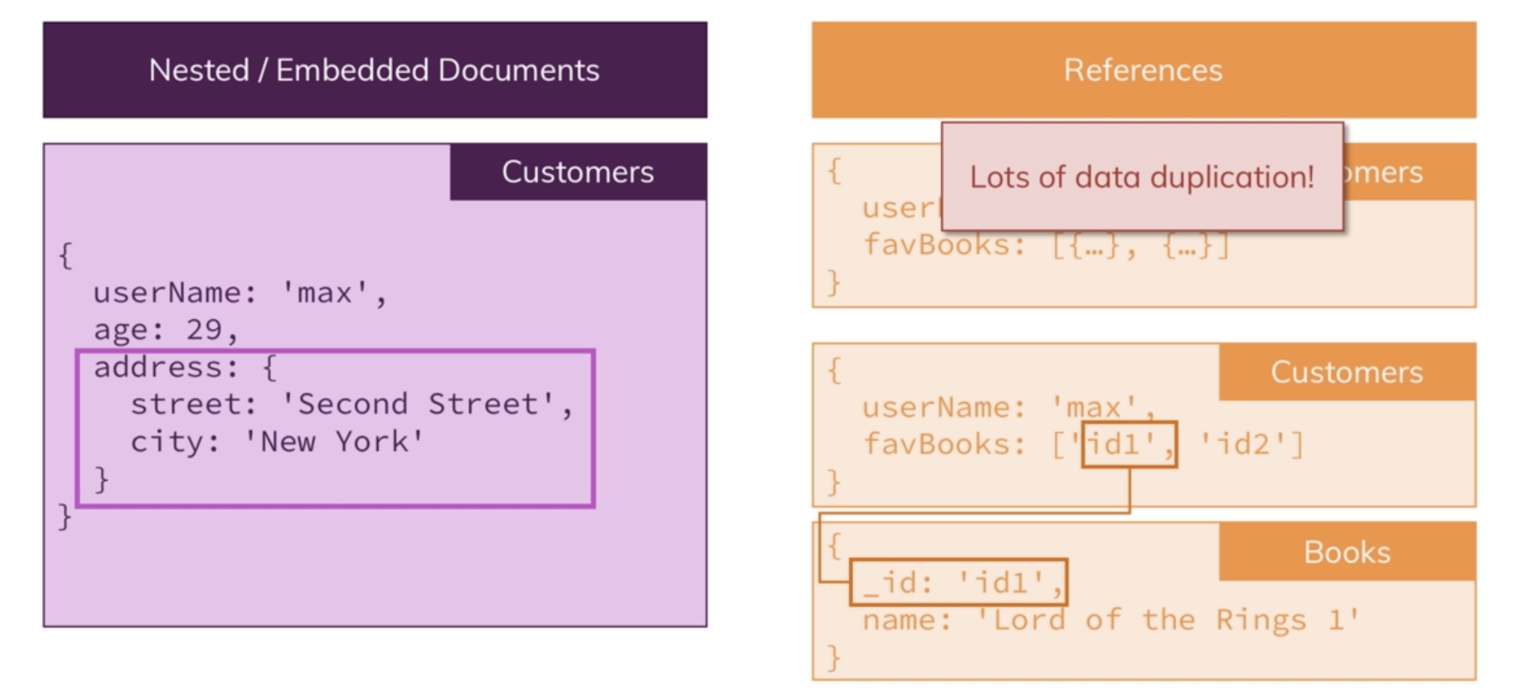
Relations in MongoDB
Notes:
Nested/Embedded Document – user document has address embedded in it. We could have stored address into a new collection or we can embed it as a separate document here.
We left it embedded because it is strongly related to the customer and we might want to fetch both at the same time
References – each customer has list of favorite books, each document could be a book. We will have a lot of duplicate data, and many customers will like the same books so if we were to change something about this favorite book, we would have to change it on all customers.
Instead we can have references – Customers and Books collections. In a Customer we still have array of favorite books, but there we only store the IDs of favorite books – when we fetch customers and also want to fetch favorite books for the customer we have to run 2 queries, but if we change a book we don’t have to change it on two different customers
Relation is through a reference
When to use which – beyond this course (data modeling in MongoDB, depends on many factors)

Slide 41
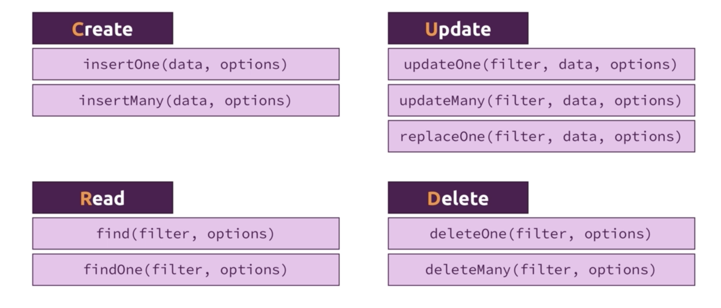
CRUD Operations JSON parser : http://parser.online.fr
Notes:
Let’s look at these in more detail.
Filter – important to filter data

Slide 42

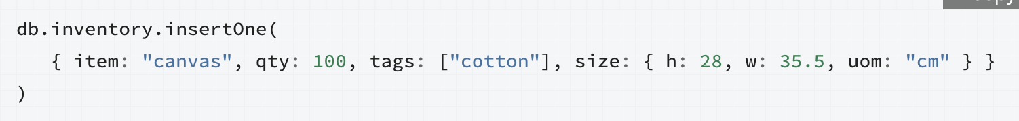
Inserting and Saving Documents
Inserts: basic method of adding data to MongoDB
Use db.collection.insertOne() or db.collection.insert() methods to insert one document
Insert adds an “_id” key to the document and store it in MongoDB

Slide 43
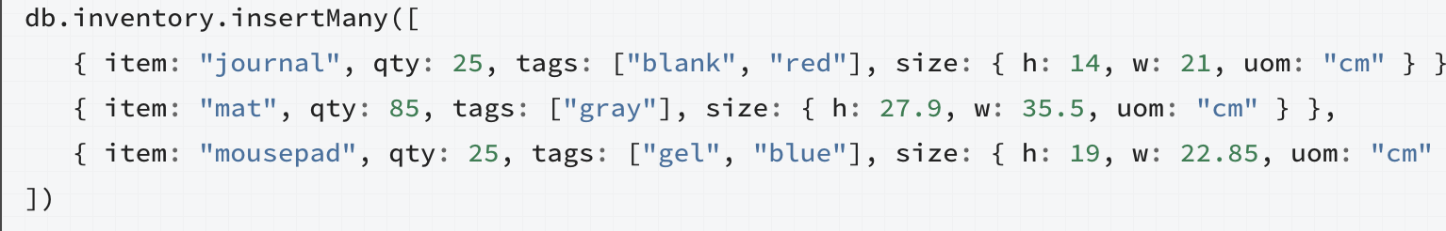
Inserting and Saving Documents
Or we can insert multiple documents
Use db.collection.insertMany to insert multiple

Slide 44
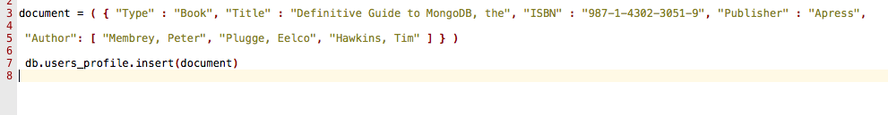
Inserting and Saving Documents
Can define data to insert first and then save it to collection using insert() function
Here we define document first and then save it

Slide 45
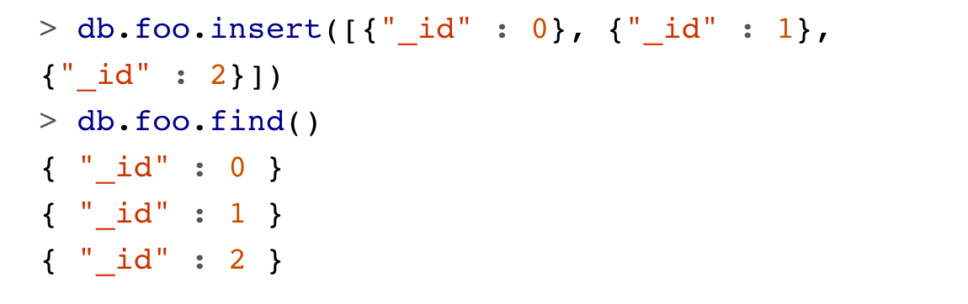
Batch Insert
Batch inserts: to insert multiple documents into collection
Allow to pass array of documents to the database
Use batchInsert function
Notes:
Batch inserts are only useful if you are inserting multiple documents into a single collection: you cannot use batch inserts to insert into multiple collections with a single request.
MongoDB does minimal checks on data being inserted: it check’s the document’s basic structure and adds an "_id" field if one does not exist. One of the basic structure checks is size: all documents must be smaller than 16 MB.
To give you an idea of how much data 16 MB is, the entire text of War and Peace is just 3.14 MB.

Slide 46

Removing Documents
Remove documents: use remove method
This will remove all of the documents in the foo collection
Any metadata about it will still exist
Remove f-n can take a query document as parameter
Only documents that match query criteria will be returned
Notes:
Suppose, for instance, that we want to remove everyone from the mailing.list collection where the value for "opt-out" is true:
Once data has been removed, it is gone forever. There is no way to undo the remove or recover deleted documents.

Slide 47
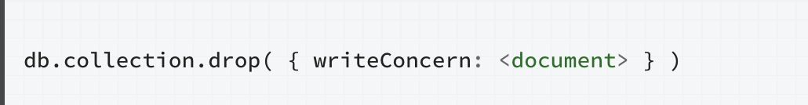
Removing Documents
To clear entire collection: drop it
Cannot specify any criteria
The whole collection is gone
All metadata is deleted
Notes:
Drop it and then recreate any indexes on the empty collection

Slide 48
Updating Documents
Use update() function to update data
Takes three arguments:
criteria – specify the query that select the record to update
objNew – specify updated information
options – specify options when updating document (upsert or multi)
Upsert – update if it exists, create if it doesn’t
Multi – whether all matching documents should be updated or just first one (default action)
Notes:
\

Slide 49
Updating Documents
Note: An upsert tells the database to update a record if a document is present or to insert a record if it isn’t
Notes:
Example 1: This example overwrites the document in the collection and saves it with the new values specified. Note that any fields that you leave out are removed (the document is basically being rewritten). Because the upsert argument is specified as true , any fields that do not exist yet will be added (the Genre key/value pair, in this case).
Example 2: In case there happen to be multiple documents matching the criteria and you wish to upsert them all, the upsert and multi options can be added while using the $set modifier operator as shown here:

Slide 50
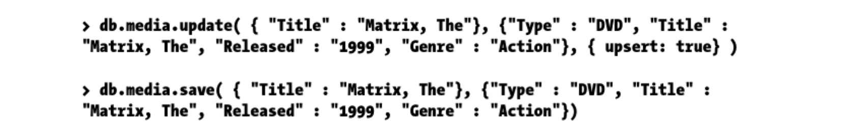
Implement Upsert with save() Command
Can perform upsert() with save
Specify _id value
Can have _id added automatically or manually
If no _id specified – MongoDB assumes its an insert
Notes:
The main benefit of using the save() command is that you do not need to specify that the upsert method should be used in conjunction with the update() command. Thus, the save() command gives you a quicker way to upsert data. In practice, the save() and update() commands look similar:

Slide 51
Set a Field’s Value
Can use $set operator to set a field’s value to one you specify
If the field does not exist yet, it will be created
Can delete specified field with $unset

Slide 52
Indexing
Data structure used by MongoDB query optimizer to sort/order documents
Like a predefined query that was executed and had results sorted
Allows us to optimize queries
Every write on indexed field (insert, update, delete) will take longer for every index we add
Use explain() function to see what MongoDB is doing when it executes a query
To choose fields for index look at common queries
Notes:
A database index is similar to a book’s index. Instead of looking through the whole book, the database takes a shortcut and just looks at an ordered list that points to the content, which allows it to query orders of magnitude faster.
Depending on your machine and how large you made the collection, creating an index may take a few minutes.
Insert/Update/Delete will take longer - This is because MongoDB has to update all your indexes whenever your data changes, as well as the document itself. Thus, MongoDB limits you to 64 indexes per collection. Generally you should not have more than a couple of indexes on any given collection.​​ The tricky part becomes figuring out which fields to index
To choose which fields to create indexes for, look through your common queries and queries that need to be fast and try to find a common set of keys from those. For instance, in the example above, we were querying on "username". If that was a particularly common query or was becoming a bottleneck, indexing "username" would be a good choice. However, if this was an unusual query or one that was only done by administrators who didn’t care how long it took, it would not be a good choice of index

Slide 53
Indexes
Create index for the same scenarios as in RDBMS
Add indexes where the number of reads is higher than the number of writes
Index information is stored in system.indexes collection
Run db.indexes.find() to see information about your indexes
To see info for specific collection use db.collection.getIndexes()
Notes:
Index - data structure that collects information about the values of specified fields in the documents of a collection. This data structure is used by MongoDB’s query optimizer to quickly sort through and order the documents in a collection.

Slide 54
Indexes and Performance
Sometimes need to rebuild indexes to clean up irregularities
When more writes occur than reads, indexes are counterproductive
Adding index increases query speed, but it reduces insertion/deletion speed
Notes:
For instance, sometimes the size of a database can increase dramatically for no apparent reason. At other times, the space used by the indexes might strike you as excessive. Another good thing to keep in mind: you can have a maximum of 40 indexes per collection. Generally speaking, this is far more than you should need, but you could potentially hit this limit someday.

Slide 55
Geospatial Indexes
Designed to work with location-based queries
Example: can use it to find a number of closest known items to the user’s current location
Document must have either a sub-object or array
First element of array has to specify object type and item’s longitude and latitude
Notes:
Note that the type parameter can be used to specify the document’s object type, which can be a Point , a LineString or a Polygon . As can be expected, the Point type is used to specify that the item (in this case, a restaurant) is located at exactly the spot given, thus requiring exactly two values, the longitute and latitude.

Slide 56
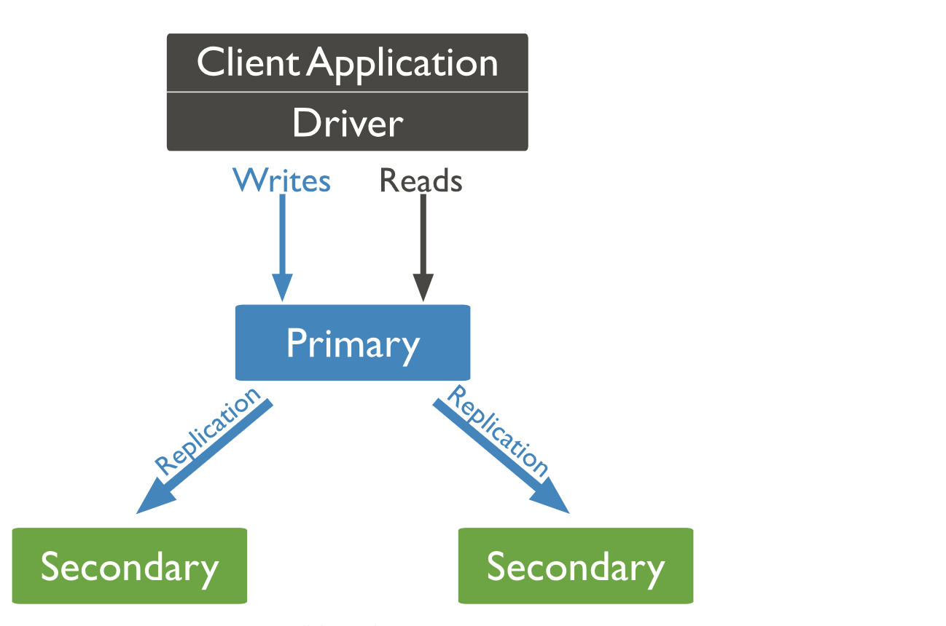
MongoDB Replica Sets
Notes:
You always communicate automatically with primary node. Insert command – talk to primary node. Behind the scenes primary node will asynchronously replicate to secondary nodes
Asynchronously – insert data, its not immediately written to secondary nodes, but relatively soon
Replicate – if primary node offline, we go to secondary node. Fault tolerance here
Improved read performance - Also, you can submit read requests to replicas – you want to ensure you can read your data as fast as possible. Thousands of reads per second → read from multiple computers.

Slide 57
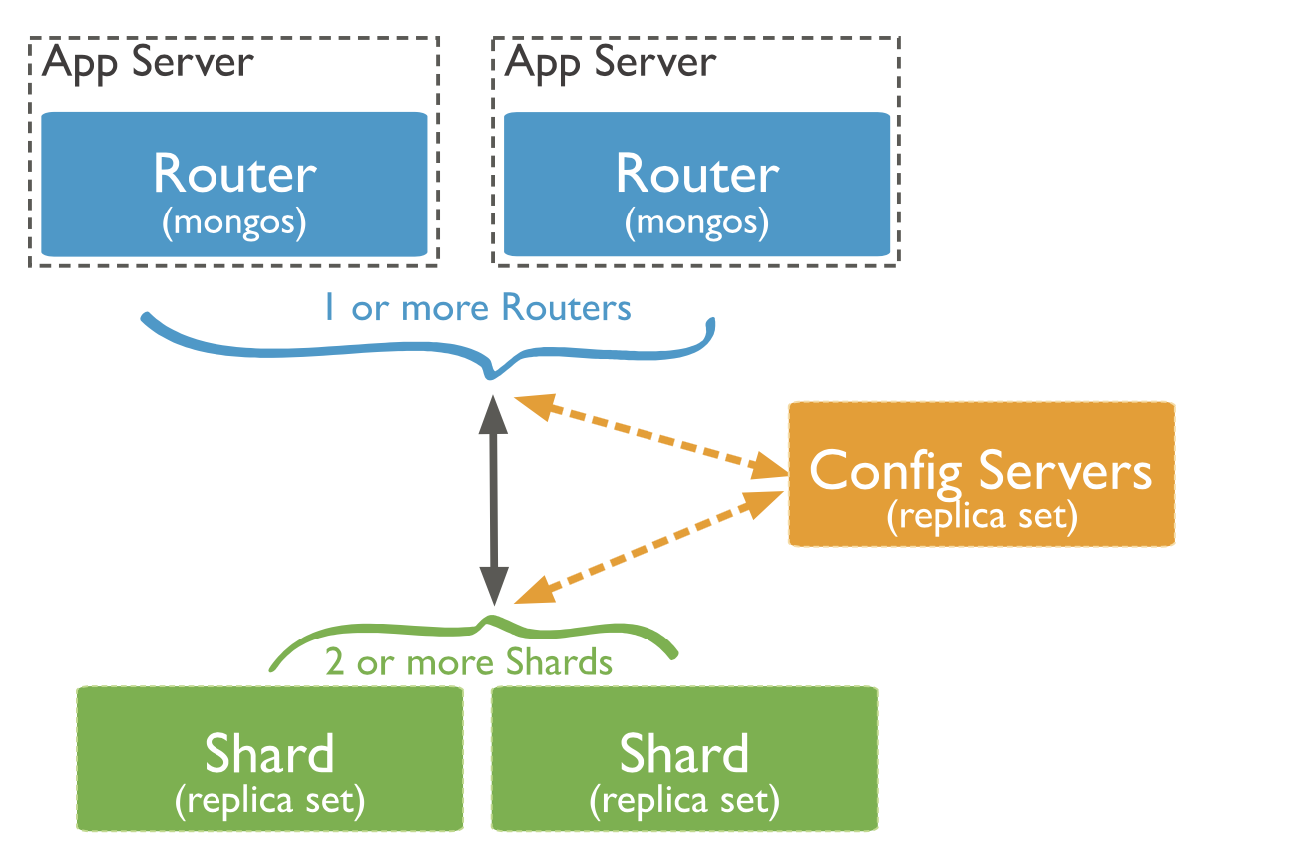
MongoDB Sharding
Notes:
Sharding – servers don’t duplicate data, they split data.
Server A stores data for the same application as the other servers, but different chunk of it
Sharding – multiple computers who all run MongoDB servers, don’t work standalone, work together and split data which is distributed across shards not replicated
and queries and insert, update, delete operations have to be run against ALL servers, each chunk manages its data, range of data (say if you had alphabetical data, first server would store A-F, second F-L, etc), so operations have to be forwarded to the right servers
Mongo Router – forwards operations from client to mongoDB shards, responsible for where the data should be stored, which shard will hold data that you want to get
Shard Key – field that is added to every document, important for the server to understand where this document belongs to

Slide 58
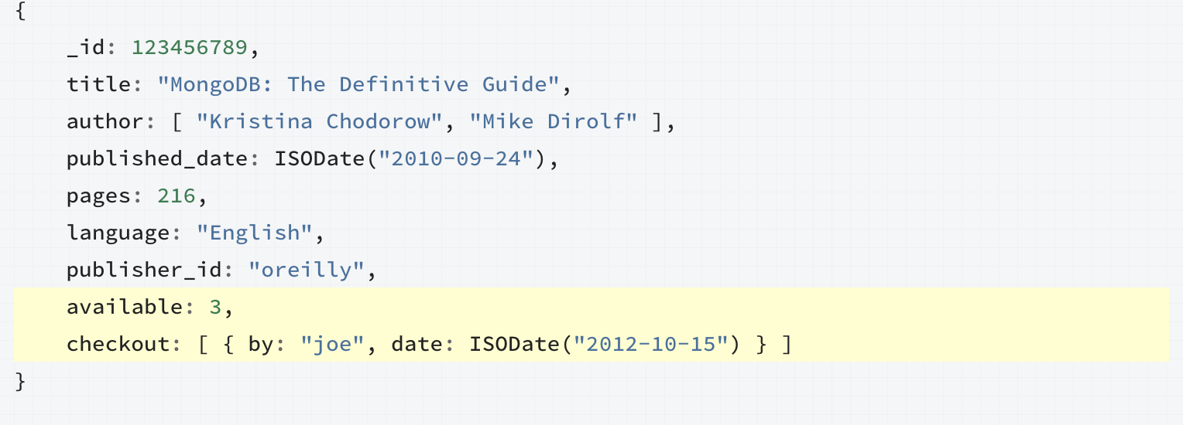
MongoDB Transactions
MongoDB supports ACID transactions on document level
Write operation on a single document is atomic
Notes:
For fields that must be updated together, embedding the fields within same document ensures that fields are updated atomically
For example, consider a situation where you need to maintain information on books, including the number of copies available for checkout as well as the current checkout information.
The available copies of the book and the checkout information should be in sync. As such, embedding the available field and the checkout field within the same document ensures that you can update the two fields atomically.
Prior to 4.0 no support for multiple document ACID
Prior to MongoDB 4.0 many MongoDB users still run relational databases in parallel with their document database
Document model negates the need for ACID transactions
Atomicity in MongoDB was restricted to single document writes and, as a result, if you find yourself in a situation where you need to update multiple documents in “all or nothing” fashion, you’re stuck. For the most part, you can and should model your data in a way that avoids super close ties between documents but there are cases where you need a transaction.
Atomicity (database systems) ... An atomic transaction is an indivisible and irreducible series of database operations such that either all occur, or nothing occurs. A guarantee of atomicity prevents updates to the database occurring only partially, which can cause greater problems than rejecting the whole series outright.

Slide 59
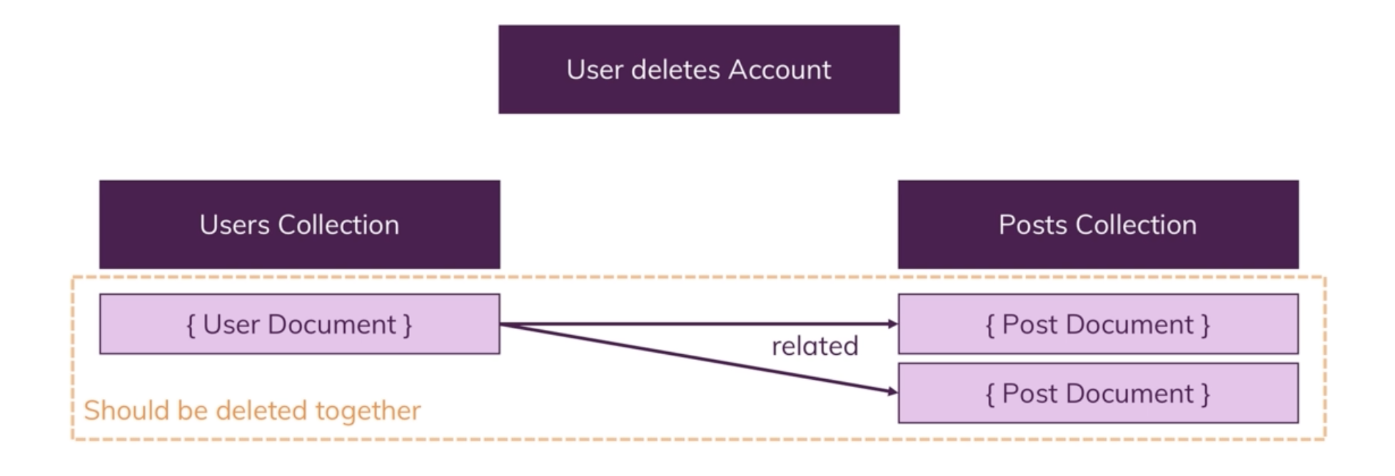
MongoDB Transactions
Notes:
We have two collections, we are deleting a user and his posts should be deleted at the same time. Without transactions we can save the id of the user before we delete it and then we can go to Posts collection, find all posts by that user and delete. What happens when somewhere in the middle of this server crashes? So user gets deleted and posts don’t.
MongoDB Transactions – either these operations succeed together or they fail together and you roll back.

Slide 60
MongoDB 4.0 Transactions
Support for multi-document ACID transactions – replica sets
Same concept as in RDBMS
Conversational
Performant
Did MongoDB support transactions before 4.0?
Yes, but only for single document
MongoDB extends these transactions across multiple documents, statements, collections and databases
Notes:
Conversational – you do reads, you do writes, everything has the same snapshot
Performant – very fast
MongoDB always supported transactions but only in a form of single document in the storage layer. Because document model brings together related data that would be otherwise modeled across separate parent-child tables in a tabular schema, MongoDB’s atomic single-document operations provide transaction semantics that meet data integrity needs.

Slide 61
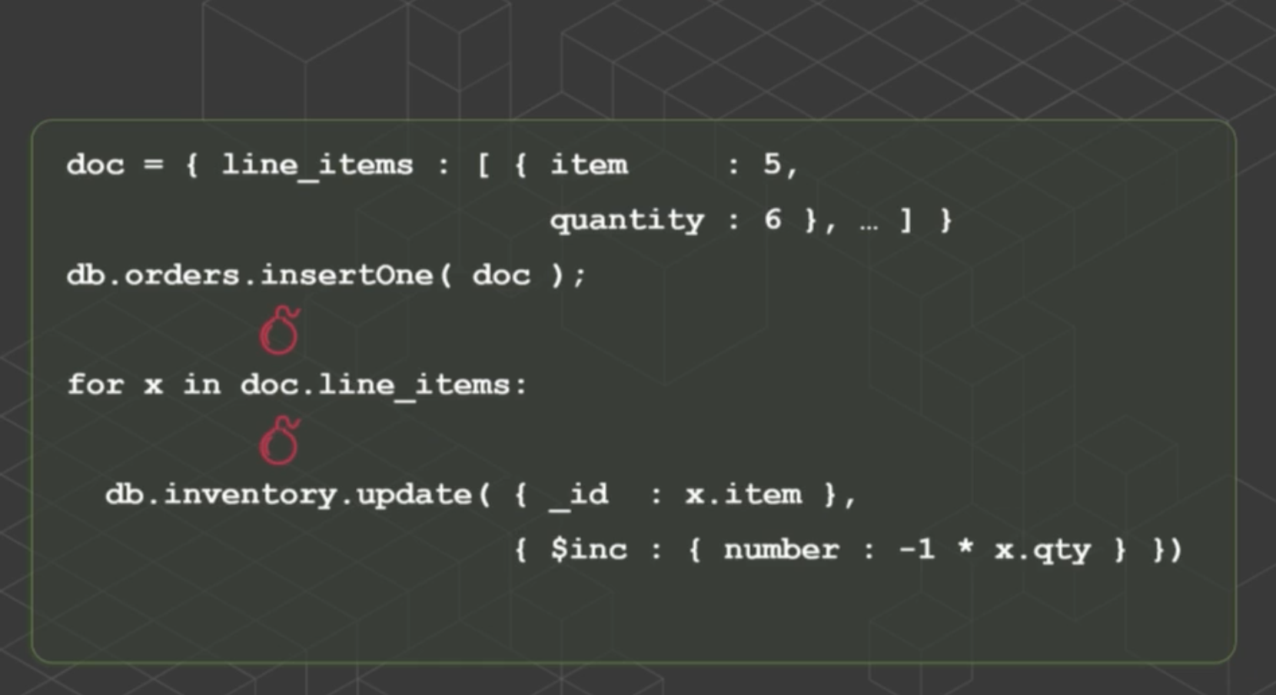
MongoDB 4.0 Transactions
Notes:
E-commerce store, lets see how you might enter an order into e-commerce store in MongoDB. We have a document, document represents an order, has a list of line items as an array.
We gonna insert that into Orders collection and for every item we purchase, we will decriment the inventory in our inventory counter by how many are purchased
Problem1: what if the program crashes after we insertOne() – inserted order and not updated our inventory counter
Problem2: what if the program crashes afte4r doc.line_items() – we may have updated some of our inventory but not all of our inventory

Slide 62
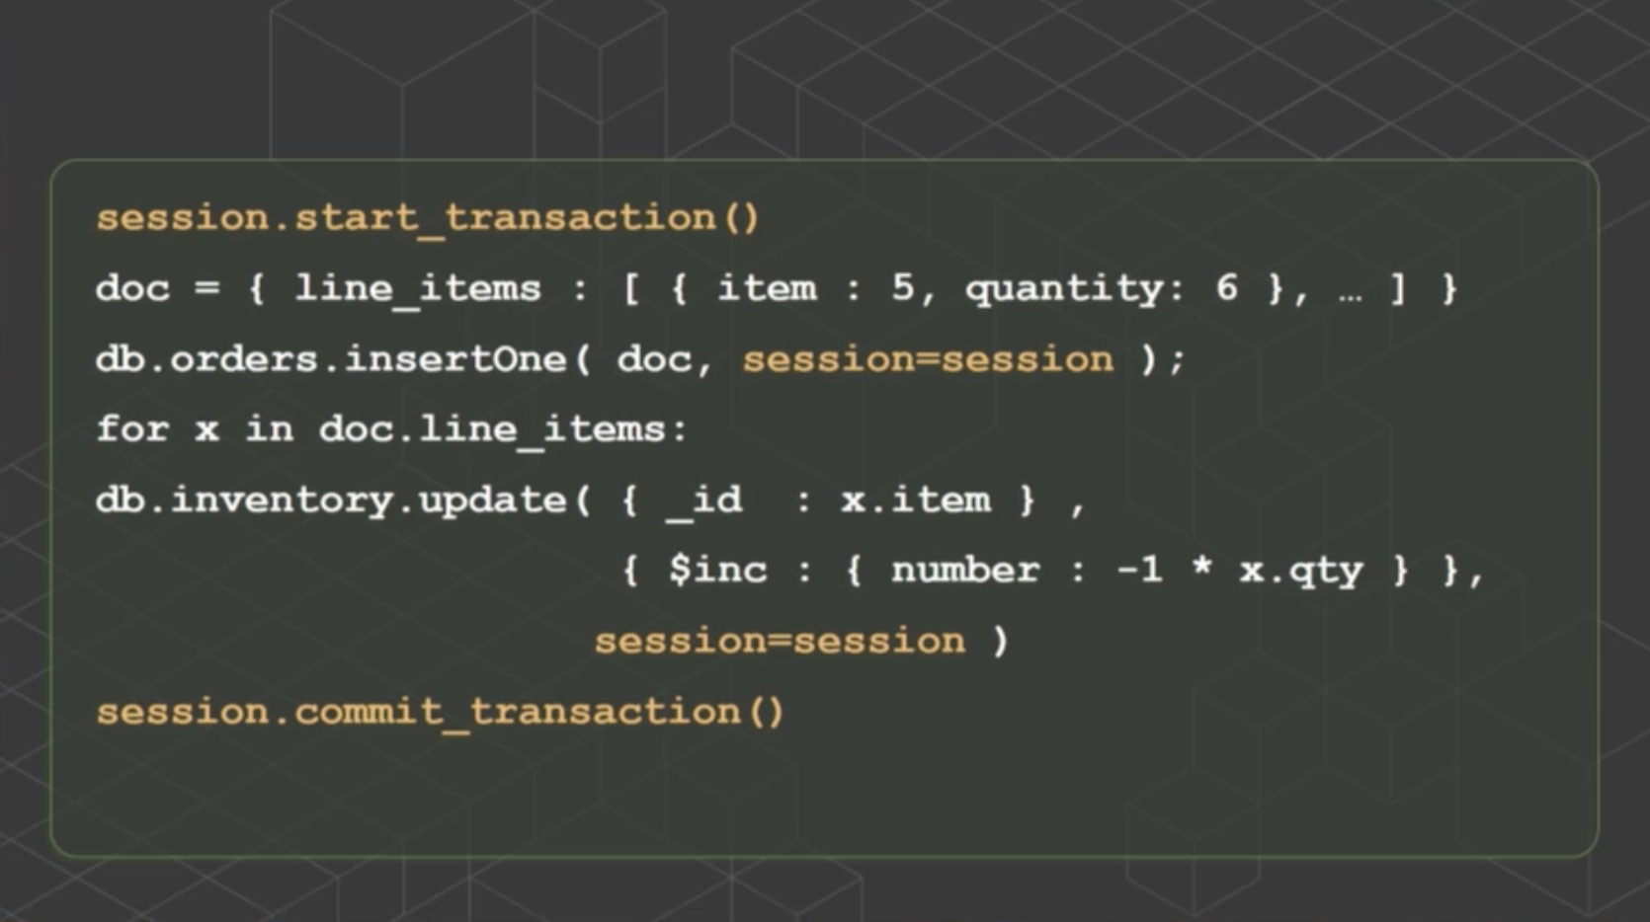
MongoDB 4.0 Transactions
Notes:
In MongoDB 4.0 you start a transaction, add that transaction to all of your read and write operations and you commit the transaction and everything will either succeed or fail
- So transactions in MongoDB are the same as in RDBMS

Slide 63
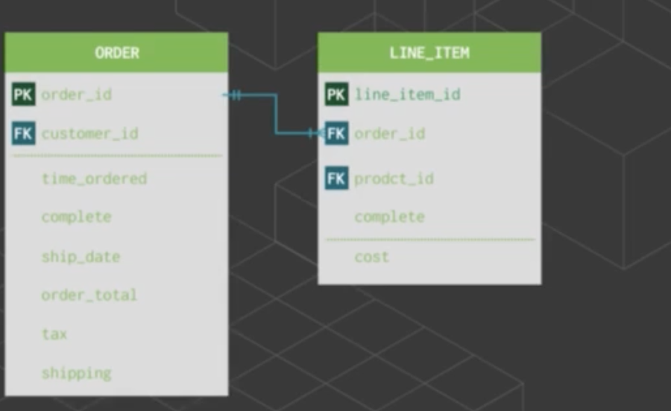
When to Use Transactions
Notes:
We don’t just take RDBMS schema move to Mongo and start using – you will lose all the benefits of Mongo if you do that
You can take your relational model for storing orders into MongoDB

Slide 64

When to Use Transactions
Notes:
You can take your relational model for storing orders into MongoDB – make them into documents
You don’t want to do that in Mongo – you want to have a single document

Slide 65

When to Use Transactions
Notes:
Beauty of Mongo – in this single document you can have still interesting queries and interesting updates
- You can still update every price in that line_item array in a single operation

Slide 66
When to use Transactions
Distinct business objects
Example: Order and inventory count
Example: Two different users transferring money
Views
Aggregate type of data
Per MongoDB – most users will use transactions but for a very small % of operations ( < 1%)
Notes:
Line items in an array are not very distinct
Views. - trying to create aggregate type of data. Every time you insert, you want to update some aggregatge view
Less then 1% of operations, You might not need transactions today, but will have confidence that you have them for later if you need them

Slide 67

JSON Schema Validation
Notes:
Sometimes we want to have strict schema, app is going to need it. Say we have insertOne() or updateOne() on our collection
If you add validation schema – MongoDB will validate the incoming data based on schema we defined and its either accepts it (allows to write to the database) or rejects it incoming data – database not changed and user gets an error message.
You can also define which kinds of operations you want to validate and what you want to do with validation when it fails (error and no change to db OR change data and log a warning)
Can define which documents will be validated
You can also set level of validation
Easy way to create validation is when you first create collection

Slide 68
JSON Schema Validation
MongoDB is schemaless database – don’t have to define schema for collection
Define rules using $jsonSchema in the db.createCollection command
$jsonSchema requires a JSON document with all the rules specified
Rules on each inserted or updated document
Required fields, types of fields, range of values, etc like in RDBMS
Notes:
The flexibility of MongoDB as a schemaless database is one of its strengths. In early versions, it was left to application developers to ensure that any necessary data validation is implemented. With the introduction of JSON Schema Validator there are new techniques to enforce data integrity for MongoDB.
MongoDB is a schemaless database. This means that we don’t have to define a fixed schema for a collection. We just need to insert a JSON document into a collection and that’s all. Documents in the same collection can have a completely different set of fields, and even the same fields can have different types on different documents. The same object can be a string in some documents and can be a number in other documents.
The real world can often be messy and MongoDB can really help, but in most cases the real world requires some kind of backbone architecture too. In real applications built on MongoDB there is always some kind of “fixed schema” or “validation rules” in collections and in documents. It’s possible to have in a collection two documents that represent two completely different things.
The $jsonSchema operator requires a JSON document where we specify all the rules to be applied on each inserted or updated document: for example what are the required fields, what type the fields must be, what are the ranges of the values, what pattern a specific field must have, and so on.

Slide 69

JSON Schema Validation
Notes:
Based on what we have defined, only 3 fields are strictly required in every document of the collection: name, surname,and email. In particular, the email field must have a specific pattern to be sure the content is a valid address. (Note: to validate an email address you need a more complex regular expression, here we just use a simpler version just to check there is the @ symbol). Other fields are not required but in case someone inserts them, we have defined a validation rule.

Slide 70

Why MongoDB?
Notes:
Document model – most natural way to store data, don’t have to break down user profile for example in 20 different tables, you store things as they naturally want to be
Dynamic – can change schema when you need to (at the same time we have JSON schema validation– database level enforcement of key attributes). As flexible and as rigid.
Great query language – simple matching or aggregation

Slide 71

Why MongoDB?

Slide 72
MongoDB LAB 2

Slide 73
Sources
“MongoDB: The Definitive Guide: Powerful and Scalable Data Storage”
“NoSQL For Mere Mortals”
“A Complete Guide to Dealing with Big Data Using MongoDB”
MongoDB World’18

